Slide 1


OPPORTUNITY REVIEW
DIRECT-TO-EMPLOYER GTM STRATEGY
Exploring a Southwestern Health Resources DTE Health Plan

Slide 2



It’s Not a Narrow Network…It’s a Smarter One!
The backbone of the DTE plan is the strategic partnerships with local providers as well as state, regional, and national networks to provide a robust provider network.
Local Healthcare Providers
State/Regional Network
Plus, KBA is partnered with over 80 health networks nationwide, to provide the best coverage and pricing available for each group’s specific needs!

Slide 3
The Key Incentive Plan
Base Medical + Preferred Plus Benefits = Your Deductible Can Simply Vanish
Example: Member with a $2,500 deductible / $4,500 max out-of-pocket has a heart attack and cardiac surgery, resulting in a 5-day in-patient stay. In this example, the member would have a $4,500 OOP with $5,050 Preferred Plus Benefits for a net OOP $0 due to the preferred provider versus $4,500 OOP exposure at any non-preferred provider.
BASE MEDICAL BENEFITS* |  |  | PREFERRED PLUS BENEFITS
Deductible |  |  | Benefits automatically included in your plan!
Single | $2,500 |  |  | Preferred Provider | Non-Preferred Provider
Family | $4,500 |  | OP Radiology/X-Ray | $200 | $0
Coinsurance |  |  | OP Diagnostic Labs | $100 | $0
80% / 20% |  |  | Preferred Hospital Stay ($500/day, 5 days) | $2,500 | $0
Maximum Out-of-Pocket |  |  | Critical Illness Benefit | $2,000 | $0
Single | $4,500 |  | Health Screening Benefit | $125 | $0
Family | $9,000 |  | Total Employee OOP | $4,500 | $4,500
Chronic Disease Management Regimens of Care Covered at 100% |  |  | Preferred Plus Benefits | $4,925 | $0
Healthcare Convience Card to Cover Out-of-Pocket Expenses at 0% interest |  |  | Employee Amount Due to Provider | $0 | $4,500
Health Guardian Account to help members manage their healthcare expenses at Preferred Providers |  |  | Additional Benefit Payable to the Health Guardian Account | $425 | $0
*Base Medical Benefits are for illustration purposes only. Base benefits can be customized to meet client needs.

Slide 4

The Benefit Steering the Patient to SWHR
What Will this Claim Cost Me?
Explanation of Benefits
Heart Attack, Cardiac Surgery
THE CHARGES
Medical Bills | $25,000
Healthcare out-of-pocket due to provider | $4,500
Since your out of pocket maximum has been met, the rest of your eligible charges this year will be paid at 100%
THE CREDITS
OP Radiology/X-Ray | $200
OP Diagnostic Labs | $100
Preferred Hospital Stay ($500/day, 5 days) | $2,500
Critical Illness Benefit | $2,000
Health Screening Benefit | $125
Benefit Total | $4,925
Out of Pocket Paid to Hospital | ($4,500)
Balance Paid to HGA | $425
SWHR patients can have all out-of-pocket liability reduced to $0!
Notes:
Can’t put 3,500 on the convenience card. Second line is not the healthcare credicard balance

Slide 5
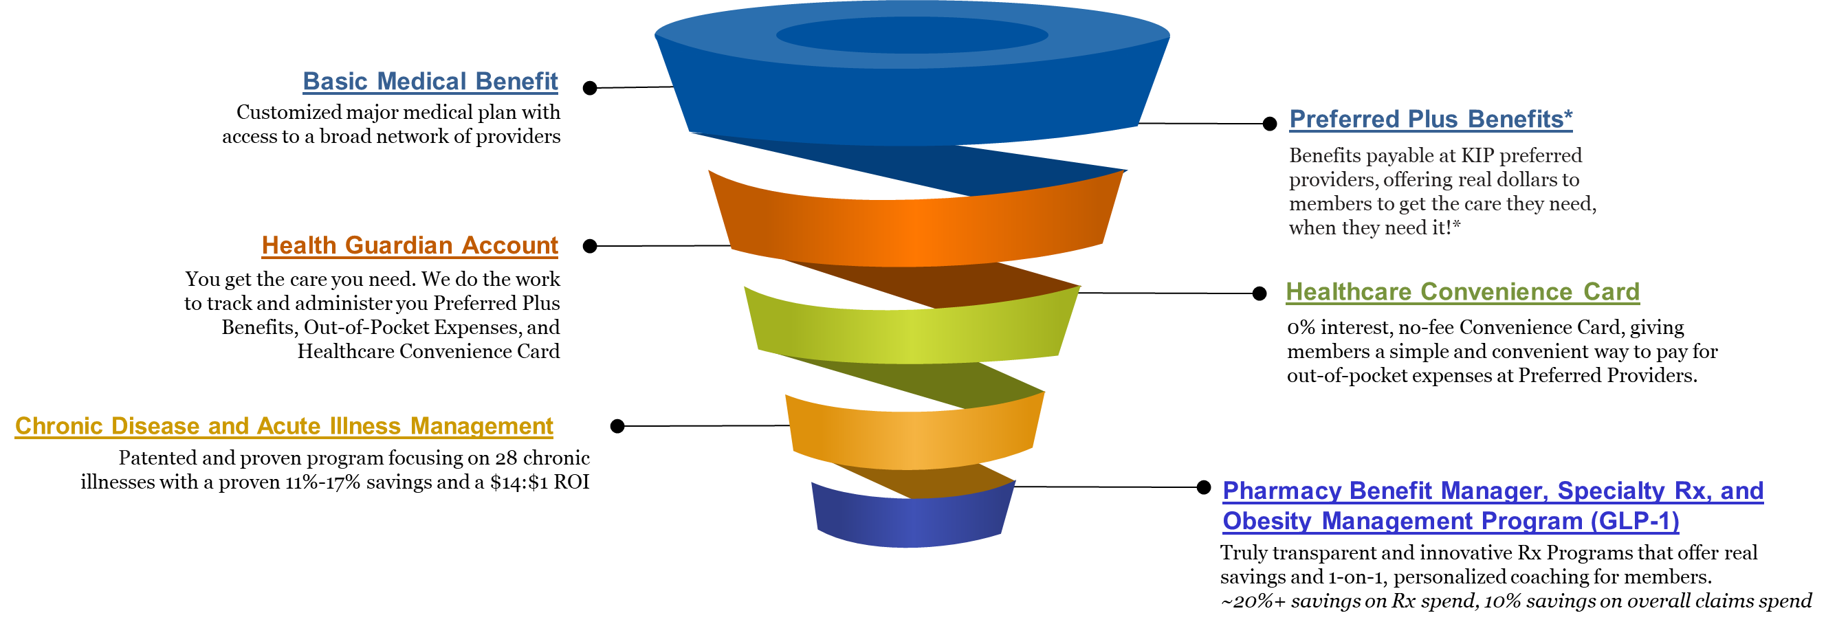
The Key Incentive Plan
Affordability Without Compromise
The Key Incentive Plan is a one-of-a-kind solution, empowering employers to take back control of their healthcare programs, that offers freedom of choice when choosing providers in your local community, while incenting members to choose high-quality, cost-effective care.
*Daily Inpatient Hospital Benefit, OP Surgery/Anasthesia, OP Radiology/X-Ray, OP Diagnostic Labs, Health Screening Benefit, Wellness Benefit, Critical Illness

Slide 6

THE KBA HEALTH CONVENIENCE CARD
Creating EPO Steerage in a PPO Network
The Health Convenience Card is eligible to be used only for specific merchant codes.
To utilize at Specific Healthcare Providers
a. Designated Hospitals
b. Urgent Care Facilities
c. Physicians
d. Eligible Ancillary Providers
Out of Pocket Expenses Qualify
0% Interest Rate
Employee Determines Repayment Schedules
5. To Qualify: Answer One Simple Question

Slide 7

Weight Management (GLP-1s) that Don't Break the Bank
The GLP-1 medication market has experienced explosive growth, fundamentally reshaping healthcare spending across America. Prime Therapeutics reports that per-member-per-month spend has tripled by March 2025, with these breakthrough medications now representing approximately 15% of total pharmacy spend. More than 1 in 50 members filed a GLP-1 claim in Q1 2025 alone, demonstrating unprecedented demand for these life-changing treatments.
The Challenge
Our Solution
The Impact
Traditional GLP-1 medications cost between $1,089-$1,349 monthly, creating unsustainable budget pressures for employers while limiting employee access to essential treatments.
Key Benefits secures generic GLP-1 medications for just $249 per month, enabling comprehensive workforce health while maintaining strict budget control and financial stability.
Deliver a healthier population, increased employee satisfaction, and sustainable costs that support long-term organizational success and employee wellbeing.
Proven Results: $7M Annual Savings
270
One major city spending $11 million annually on GLP-1 medications achieved $7 million in cost savings through our comprehensive approach. This dramatic reduction demonstrates how strategic sourcing combined with clinical support creates sustainable, scalable solutions for large employers facing escalating pharmaceutical costs.
Health Conditions
Beyond Medication: Comprehensive Care
Created or exacerbated by obesity according to Cleveland Clinic research
Our program extends far beyond cost-effective medication access. Members receive specialized coaching twice monthly, focusing on maintaining muscular strength, engaging in moderate exercise, and developing sustainable lifestyle changes that support long-term weight maintenance after GLP-1 treatment completion.
$8.5K
Additional Spend
Average annual healthcare costs above normal for obese individuals (KFF)
Transform Your Healthcare Strategy: Join forward-thinking employers who are providing comprehensive weight management solutions while protecting their bottom line. Our approach combines clinical excellence with fiscal responsibility, creating a win-win for organizations and their valued employees.

Slide 8

COMMUNITY BASED SALES STRATEGY
Locally based sales rep with strong community ties
Collaboration with DTE provider partners to identify strategic employers for early adoption and sales
Work with select broker distribution partners with aligned incentives and goals
Pipeline reporting and collaboration with our DTE provider partners
Marketing and promotion of the new option in the community

Slide 9


Complete Marketing System
Customized Branding and Messaging
Customized Brochures
Customized Web Site
Targeted Employer Outreach
Sales System (Social Media, Email, Text, etc.)

Slide 10
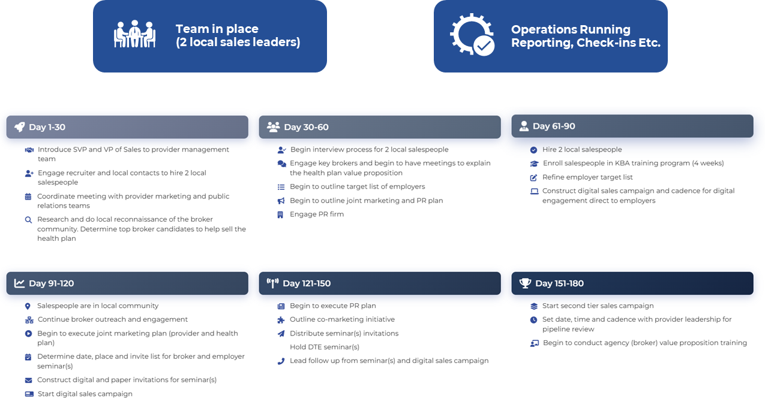
180 DAY SALES TARGETS AND PLAN

Slide 11
STOP-LOSS INSURANCE THE KBA EXPERIENCE
Tokio Marine
Nationwide
Berkshire Hathaway
Sun Life
Liberty Mutual
Granular (Google)
Companion Life
Crum & Forster
American Fidelity
RGA
Deep relationships with 20+ stop loss underwriters and carriers
Over $150M in annual stop loss premium placement
Comprehensive pricing and medical service analysis performed for each DTE health plan to ensure proper pricing
KBA provides the administration required of the stop-loss markets:
Bordereau Reporting
Claim Reporting and Reconciliation
Evaluation of Networks
Care Management
Initial Underwriting
Negotiation of rates and terms
Plan Design Actuarial

Slide 12
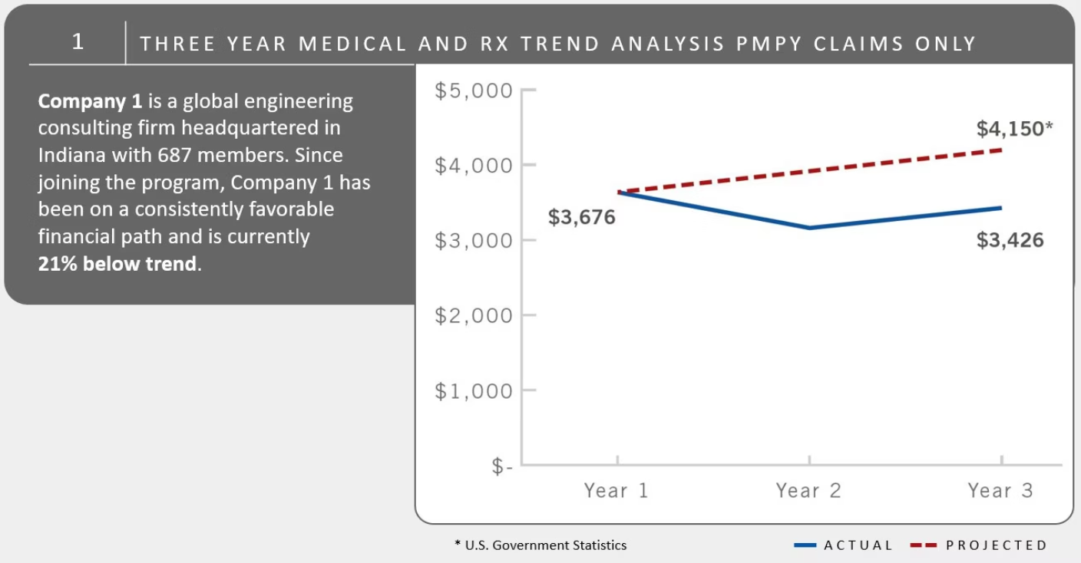
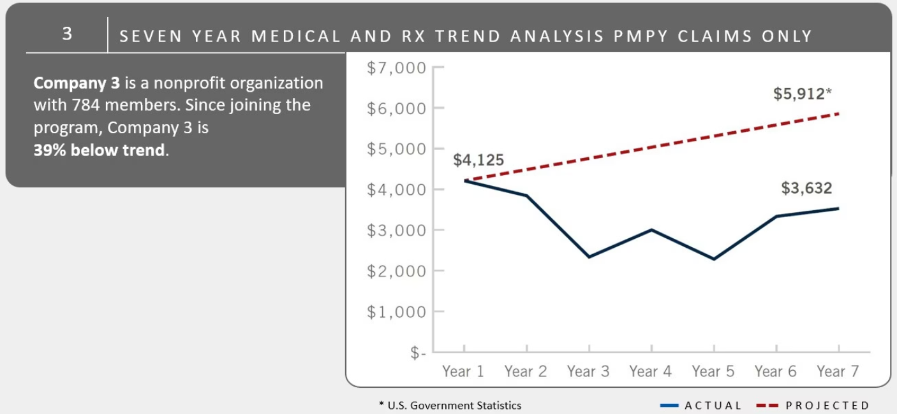
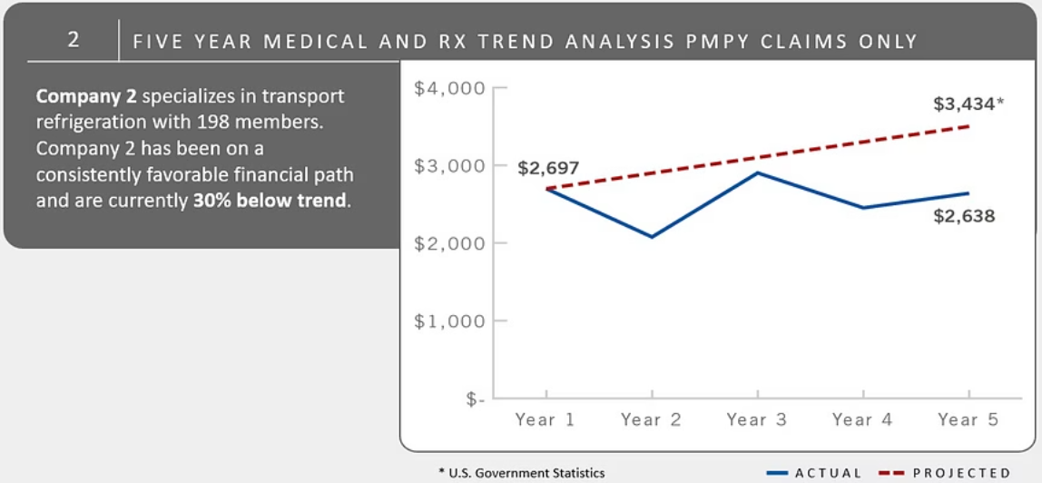

Proof: 98% of Our Clients Beat Healthcare Inflation
The Red Line = Healthcare CPI
The year-over-year healthcare component of the consumer price index represents typical market healthcare cost increases that employers face nationwide.
The Blue Line = Main Street Management
What happens when you manage your health on Main Street with direct provider relationships, transparent pricing, and aligned incentives.
For our clients, 98% of our Blue Lines are BELOW their Red Lines!
This consistent outperformance demonstrates that direct-to-employer partnerships deliver measurable, sustainable value for all stakeholders involved.

